Slide 1

Parallel & Distributed Computing
Hardware Architectures
Lecture-3A

Slide 2

Hardware Architectures
Hardware architecture refers to the identification of a system's physical components and their interrelationships.
This description, often called a hardware design model, allows hardware designers to understand how their components fit into a system architecture and provides to software component designers important information needed for software development and integration.

Slide 3
Hardware Architectures cont…
Architecture is a set of rules and methods that describe the functionality, organization, and implementation of computer.
Architecture is concerned with balancing the performance, efficiency, cost, and reliability of a computer system.

Slide 4
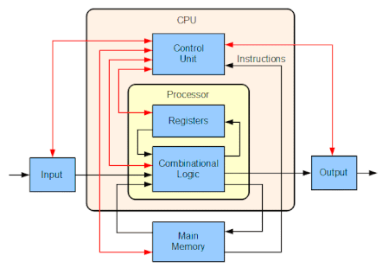
Hardware Architectures cont…
functionality
organization
implementation

Slide 5

Hardware Architectures cont… Flynn’s Taxonomy
Michael J. Flynn (born May 20, 1934) is an American professor at Stanford University.
Flynn proposed the Flynn's taxonomy, a method of classifying digital computer architectures, in 1966

Slide 6
Hardware Architectures cont… Flynn’s Taxonomy
The four classifications based upon the number of concurrent instruction (or control) streams and data streams available in the architecture:
Single instruction stream, single data stream (SISD)
Single instruction stream, multiple data streams (SIMD)
Multiple instruction streams, single data stream (MISD)
Multiple instruction streams, multiple data streams (MIMD)

Slide 7
Hardware Architectures cont… Flynn’s Taxonomy
Instruction stream: The sequence of instructions from memory to the control unit.
Data stream: The sequence of data from memory to the control unit.

Slide 8
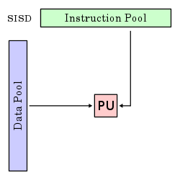
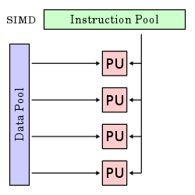
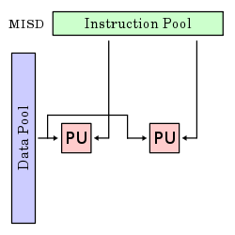
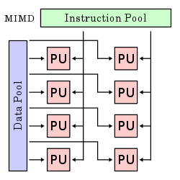
Hardware Architectures cont… Flynn’s Taxonomy

Slide 9
Hardware Architectures cont… Flynn’s Taxonomy
Instruction stream: The sequence of instructions from memory to the control unit.
Data stream: The sequence of data from memory to the control unit.

Slide 10
Hardware Architectures cont… Flynn’s Taxonomy (SISD)
A sequential computer which exploits no parallelism in either the instruction or data streams.
Single control unit (CU) fetches single instruction stream (IS) from memory.
The CU then generates appropriate control signals to direct single processing element (PE) to operate on single data stream (DS) i.e., one operation at a time.

Slide 11
Hardware Architectures cont… Flynn’s Taxonomy (SISD)
It requires less power.
There is no issue of complex communication protocol between multiple cores.
The speed of SISD architecture is limited just like single-core processors.
It is not suitable for larger applications.

Slide 12
Hardware Architectures cont… Flynn’s Taxonomy (SIMD)
A single instruction operates on multiple different data streams.
Instructions can be executed sequentially, such as by pipelining, or in parallel by multiple functional units.

Slide 13
Hardware Architectures cont… Flynn’s Taxonomy (SIMD)
Throughput of the system can be increased by increasing the number of cores of the processor.
Processing speed is higher than SISD architecture.
There is complex communication between numbers of cores of processor.
The cost is higher than SISD architecture.

Slide 14
Hardware Architectures cont… Flynn’s Taxonomy (MISD)
Multiple instructions operate on one data stream.
Systems with MISD stream have number of processing units performing different operations by executing different instructions on the same data set.

Slide 15
Hardware Architectures cont… Flynn’s Taxonomy (MIMD)
Multiple autonomous processors simultaneously executing different instructions on different data.
MIMD architectures include multi-core superscalar processors, and distributed systems, using either one shared memory space or a distributed memory space.

Slide 16
Parallel & Distributed Computing
Hardware Architectures: Multiprocessors (Shared Memory)
Lecture-3B

Slide 17
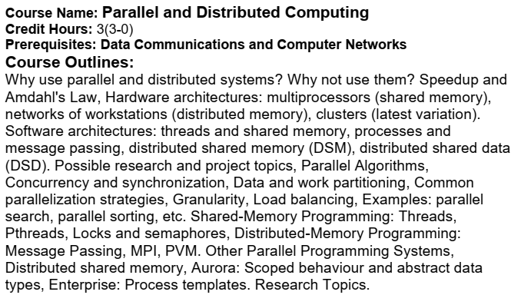
Course Outlines

Slide 18
Hardware Architectures cont… Shared Memory
Shared memory is memory that simultaneously accessed by multiple programs with an intent to provide communication among them or avoid redundant copies.
Shared memory is an efficient means of passing data between programs.
Depending on context, programs may run on a single processor or on multiple separate processors.

Slide 19
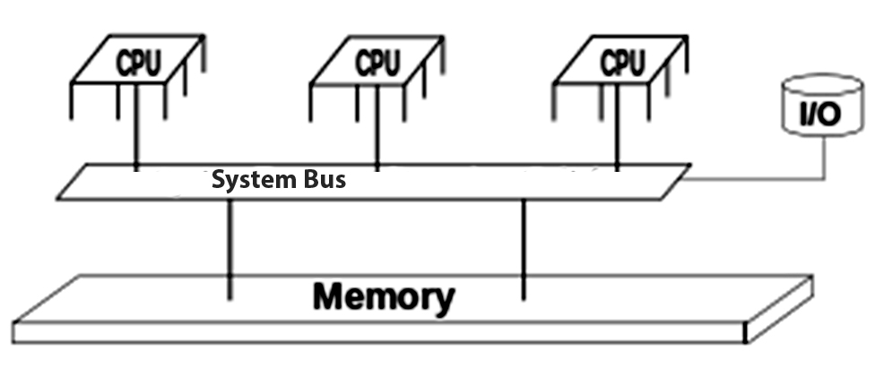
Hardware Architectures cont… Shared Memory

Slide 20
Hardware Architectures cont… Shared Memory
Shared memory concept is not only existed at hardware.
It is rather a joint venture of Hardware and Software.
Let us discuss in upcoming slides:

Slide 21
Hardware Architectures cont… Shared Memory (Hardware Level)
In computer hardware, shared memory refers to a (typically large) block of Random Access Memory (RAM) that can be accessed by several different Central Processing Units (CPUs) in a multiprocessor computer system.
In shared memory systems following different approaches may followed:

Slide 22
Hardware Architectures cont… Shared Memory (Hardware Level)
Uniform memory Access (UMA): all the processors share the physical memory uniformly (e.g. access time is same etc.);
Non-uniform Memory Access (NUMA): memory access time depends on the memory location relative to a processor;
Cache-only Memory Architecture (COMA): the local memories for the processors at each node is used as cache instead of as actual main memory.

Slide 23
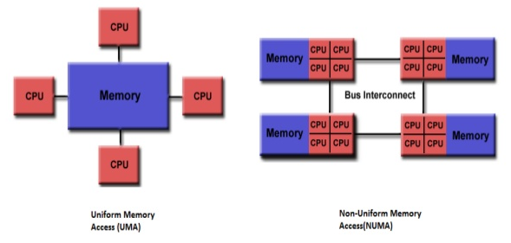
Hardware Architectures cont… Shared Memory (Hardware Level)

Slide 24
Hardware Architectures cont… Shared Memory (Hardware Level)
An Advantage: A shared memory system is relatively easy to program since all processors share a single view of data and the communication between processors can be as fast as memory accesses to a same location.

Slide 25
Hardware Architectures cont… Shared Memory (Hardware Level)
A Challenge: The issue with shared memory systems is that many CPUs need fast access to memory and will likely cache memory, which has two complications:
Access Time Degradation: when several processors try to access same memory location it causes contention (conflict).

Slide 26
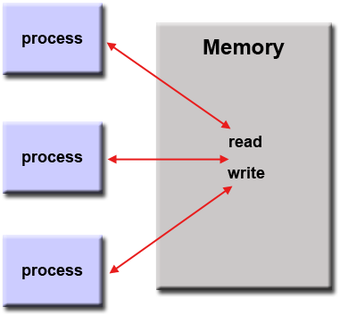
Hardware Architectures cont… Shared Memory (Hardware Level)
Access Time Degradation:
Various mechanisms can be used to aid this, including locks, semaphores, mutexes.

Slide 27
Hardware Architectures cont… Shared Memory (Hardware Level)
Lack of data Coherence: whenever one cache is updated with information that may be used by other processors, the change needs to be reflected to the other processors, otherwise the different processors will be working with incoherent data.

Slide 28
Hardware Architectures cont… Shared Memory (Hardware Level)
Incoherent caches: The caches have different values of a single address location.

Slide 29
Hardware Architectures cont… Shared Memory (Hardware Level)
Coherent caches: The data in all the caches' copies is the same.

Slide 30
Hardware Architectures cont… Shared Memory (Software Level)
At software level, shared memory can be managed by either:
A method of inter-process communication (IPC), i.e. a way of exchanging data between programs running at the same time.

Slide 31
Hardware Architectures cont… Shared Memory (Software Level)
A method of conserving memory space by directing accesses to what would ordinarily be copies of a piece of data to a single instance instead, by using virtual memory mappings or with explicit support of the program in question.
Notes:
Conserving → saving

Slide 32
Hardware Architectures cont… Shared Memory (Software Level)
Since both processes can access the shared memory area like regular working memory, this is a very fast way of communication.
On the other hand, it is less scalable, and care must be taken to avoid issues if processes sharing memory are running on separate CPUs and the underlying architecture is not cache coherent.
Notes:
Coherent → clear

